Slide 1

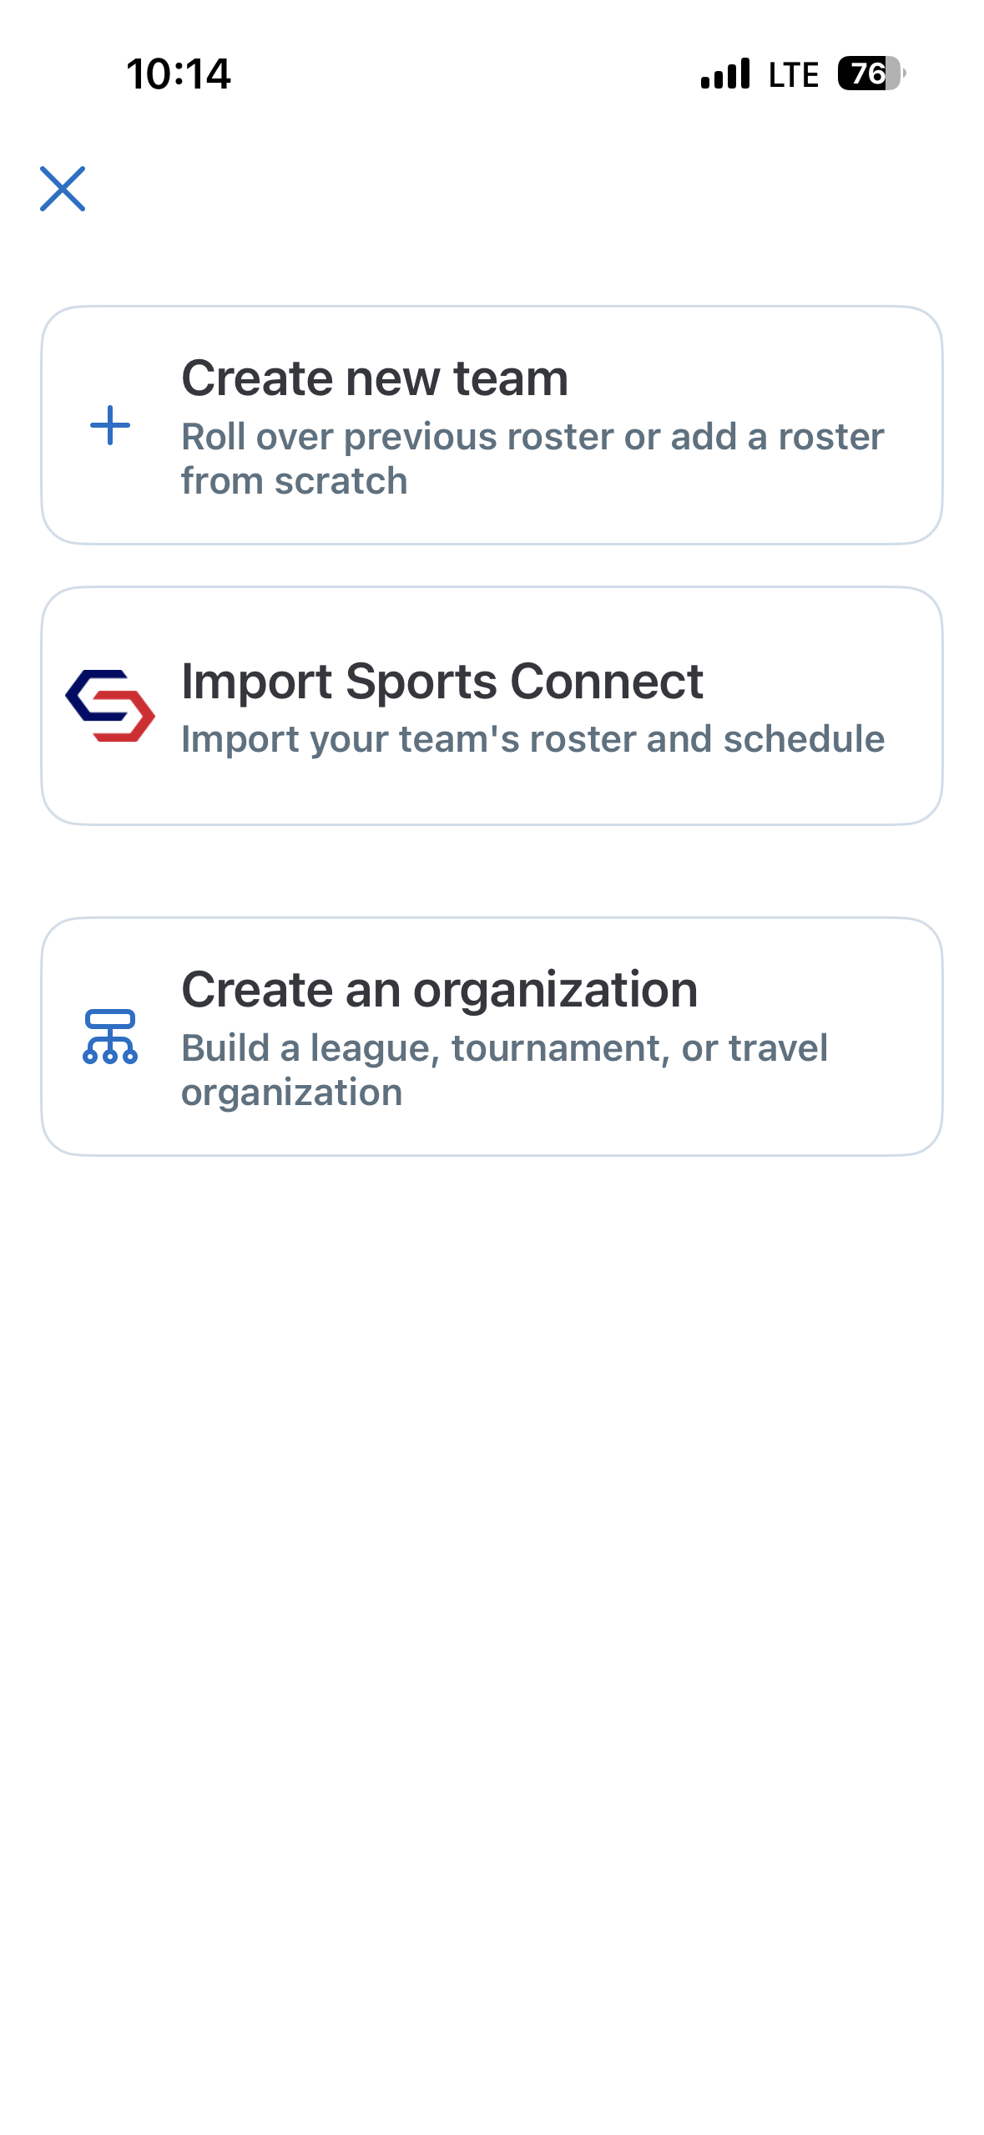
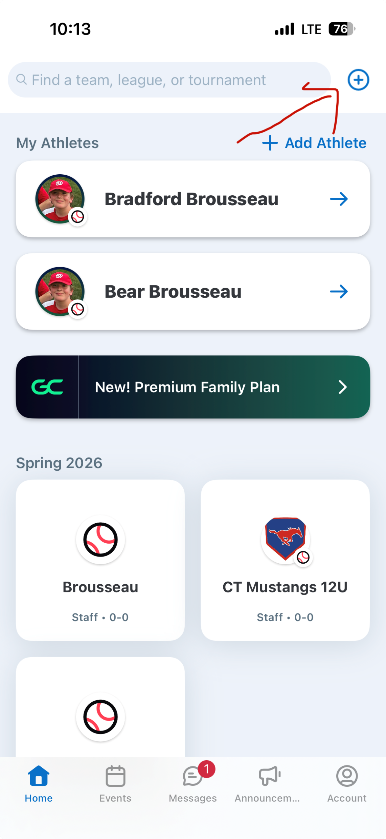
Finding Your Team in GameChanger
Note: This only works if you are registered as a Team Manager
Step 1: Download the GameChanger App to your phone.
Step 2: Setup your GameChanger account using the same email account that you use for the Woodstock Little League website
Step 3: On the home page of the app select the “+” sign in the upper right hand corner to import a team
Step 4: Select “Import Sports Connect”. This will automatically import your team
If your team is not found there are generally three issues.
Your GC email does not match your WLL account email
You are not registered as a Team Manager
Your roster needs to be reposted.
Please email woodstocklittleleaguepresident@yahoo.com Send your GC email address and we can check for any of these issues.

